Slide 1
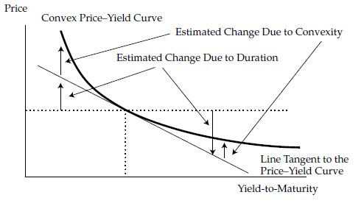
Module5 Understanding Fixed-Income Risk and Return
BOND CONVEXITY
Duration (in particular, money duration) estimates the change in the bond price along the straight line that is tangent to the curved line. The convexity statistic for the bond is used to improve the estimate of the percentage
price change provided by modified duration alone.
%ΔP≈ -MD* Δy + 0.5*C* (Δy)²

Slide 2
Module5 Understanding Fixed-Income Risk and Return
Suppose that the yield-to-maturity is expected to fall by 10 bps, from 2.935% to 2.835%. Given the (annual) modified duration of 29.163 and (annual) convexity of 864.9, calculate the expected percentage price change.
%ΔP = - 29.163 * (-0.0010) + 0.5 * 864.9 * (-0.0010)²
= 0.029163+0.000432 = 0.029595

Slide 3

Module5 Understanding Fixed-Income Risk and Return
BOND CONVEXITY
ApproxCon = $\frac{\left(PV−\right)+\left(PV+\right)−2∗(PV0)}{\left(Δy\right)2∗(PV0)}$

Slide 4
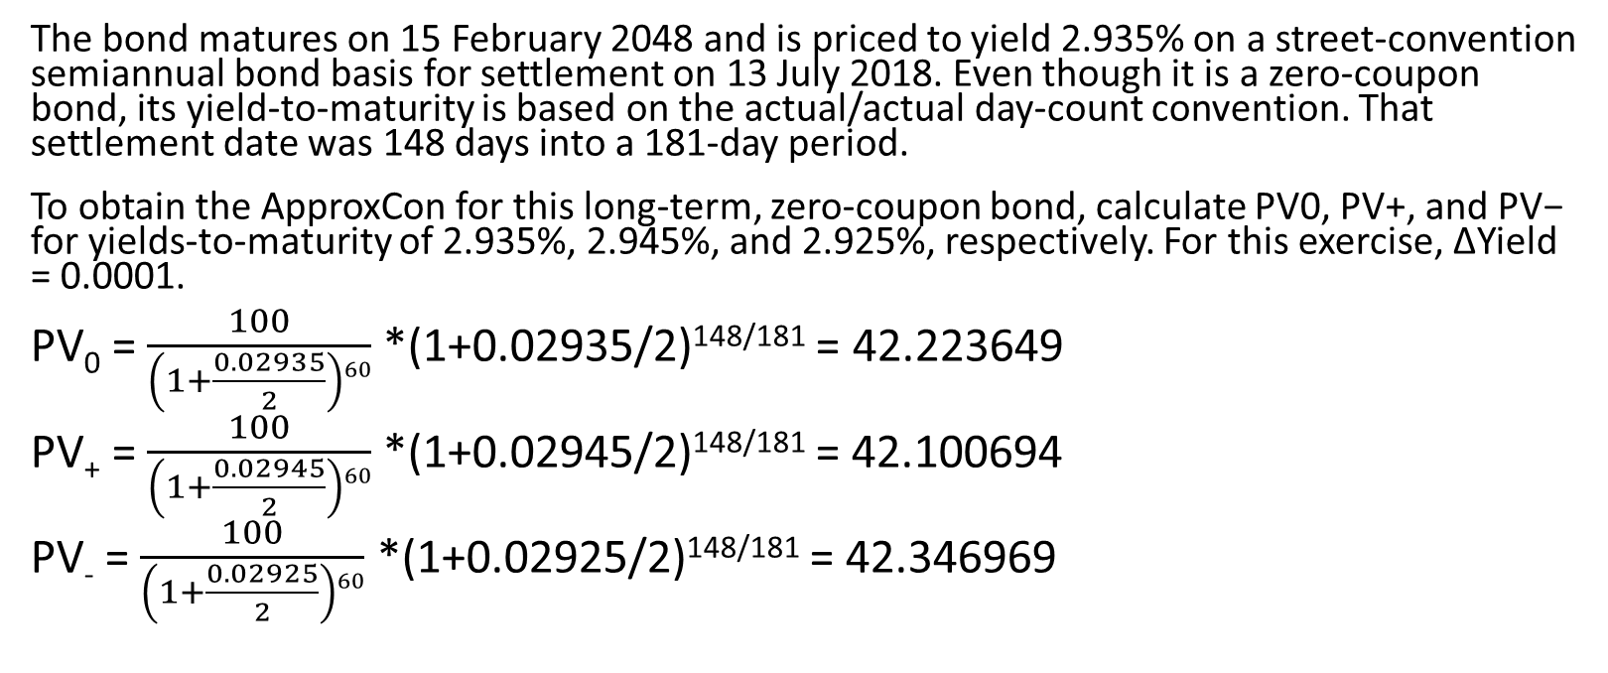
Module5 Understanding Fixed-Income Risk and Return
The bond matures on 15 February 2048 and is priced to yield 2.935% on a street-convention semiannual bond basis for settlement on 13 July 2018. Even though it is a zero-coupon bond, its yield-to-maturity is based on the actual/actual day-count convention. That settlement date was 148 days into a 181-day period.
To obtain the ApproxCon for this long-term, zero-coupon bond, calculate PV0, PV+, and PV− for yields-to-maturity of 2.935%, 2.945%, and 2.925%, respectively. For this exercise, ΔYield = 0.0001.
PV₀ = $\frac{100}{\left(1+\frac{0.02935}{2}\right)60}$ *(1+0.02935/2)^{148/181} = 42.223649
PV₊ = $\frac{100}{\left(1+\frac{0.02945}{2}\right)60}$ *(1+0.02945/2)^{148/181} = 42.100694
PV₋ = $\frac{100}{\left(1+\frac{0.02925}{2}\right)60}$ *(1+0.02925/2)^{148/181} = 42.346969

Slide 5
Module5 Understanding Fixed-Income Risk and Return
Money convexity
ΔP≈ -MoneyDur* Δy + 0.5*MoneyCon* (Δy)²
MoneyCon = Con * P₀

Slide 6
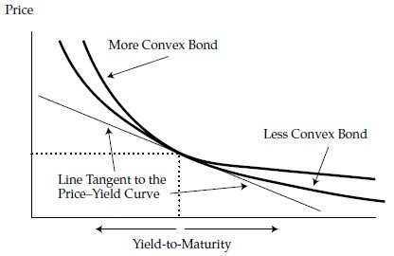
Module5 Understanding Fixed-Income Risk and Return
A fixed-rate bond with a longer time-to-maturity, a lower coupon rate, and a lower yield-to-maturity has greater convexity than a bond with a shorter time-to-maturity, a higher coupon rate, and a higher yield-to-maturity.
If two bonds have the same duration, the one that has the greater dispersion of cash flows has the greater convexity.

Slide 7

Module5 Understanding Fixed-Income Risk and Return
Consider again the callable bond example in our initial discussion of effective duration. It is assumed that an option-pricing model is used to generate these callable bond prices: PV0 = 101.060489, PV+ = 99.050120, PV− = 102.890738, and ΔCurve = 0.0025.
EffCon = $\frac{102.890738+101.060489−2∗101.060489}{0.00252∗101.060489}$ = -285.17

